Slide 1


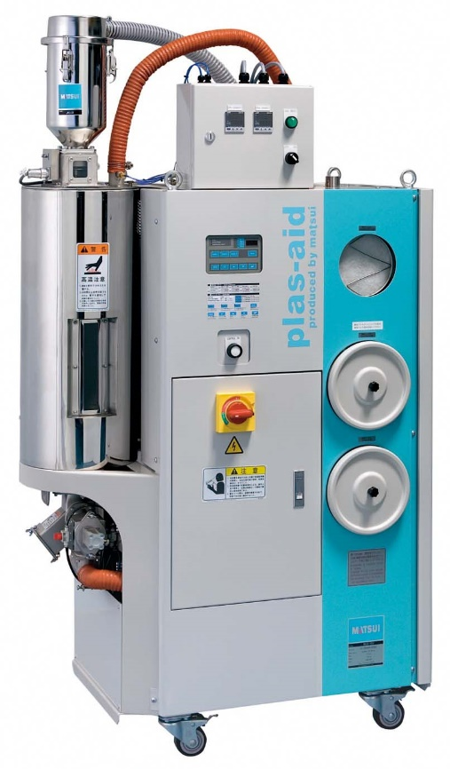
Because
we are MATSUI !
You can retrofit to existing machines!
～ MJ3-SE ～
(Drying Adjustment System)
Patent No. JP 5211056
（Japan Patent）
MJ3-10-SE

Slide 2

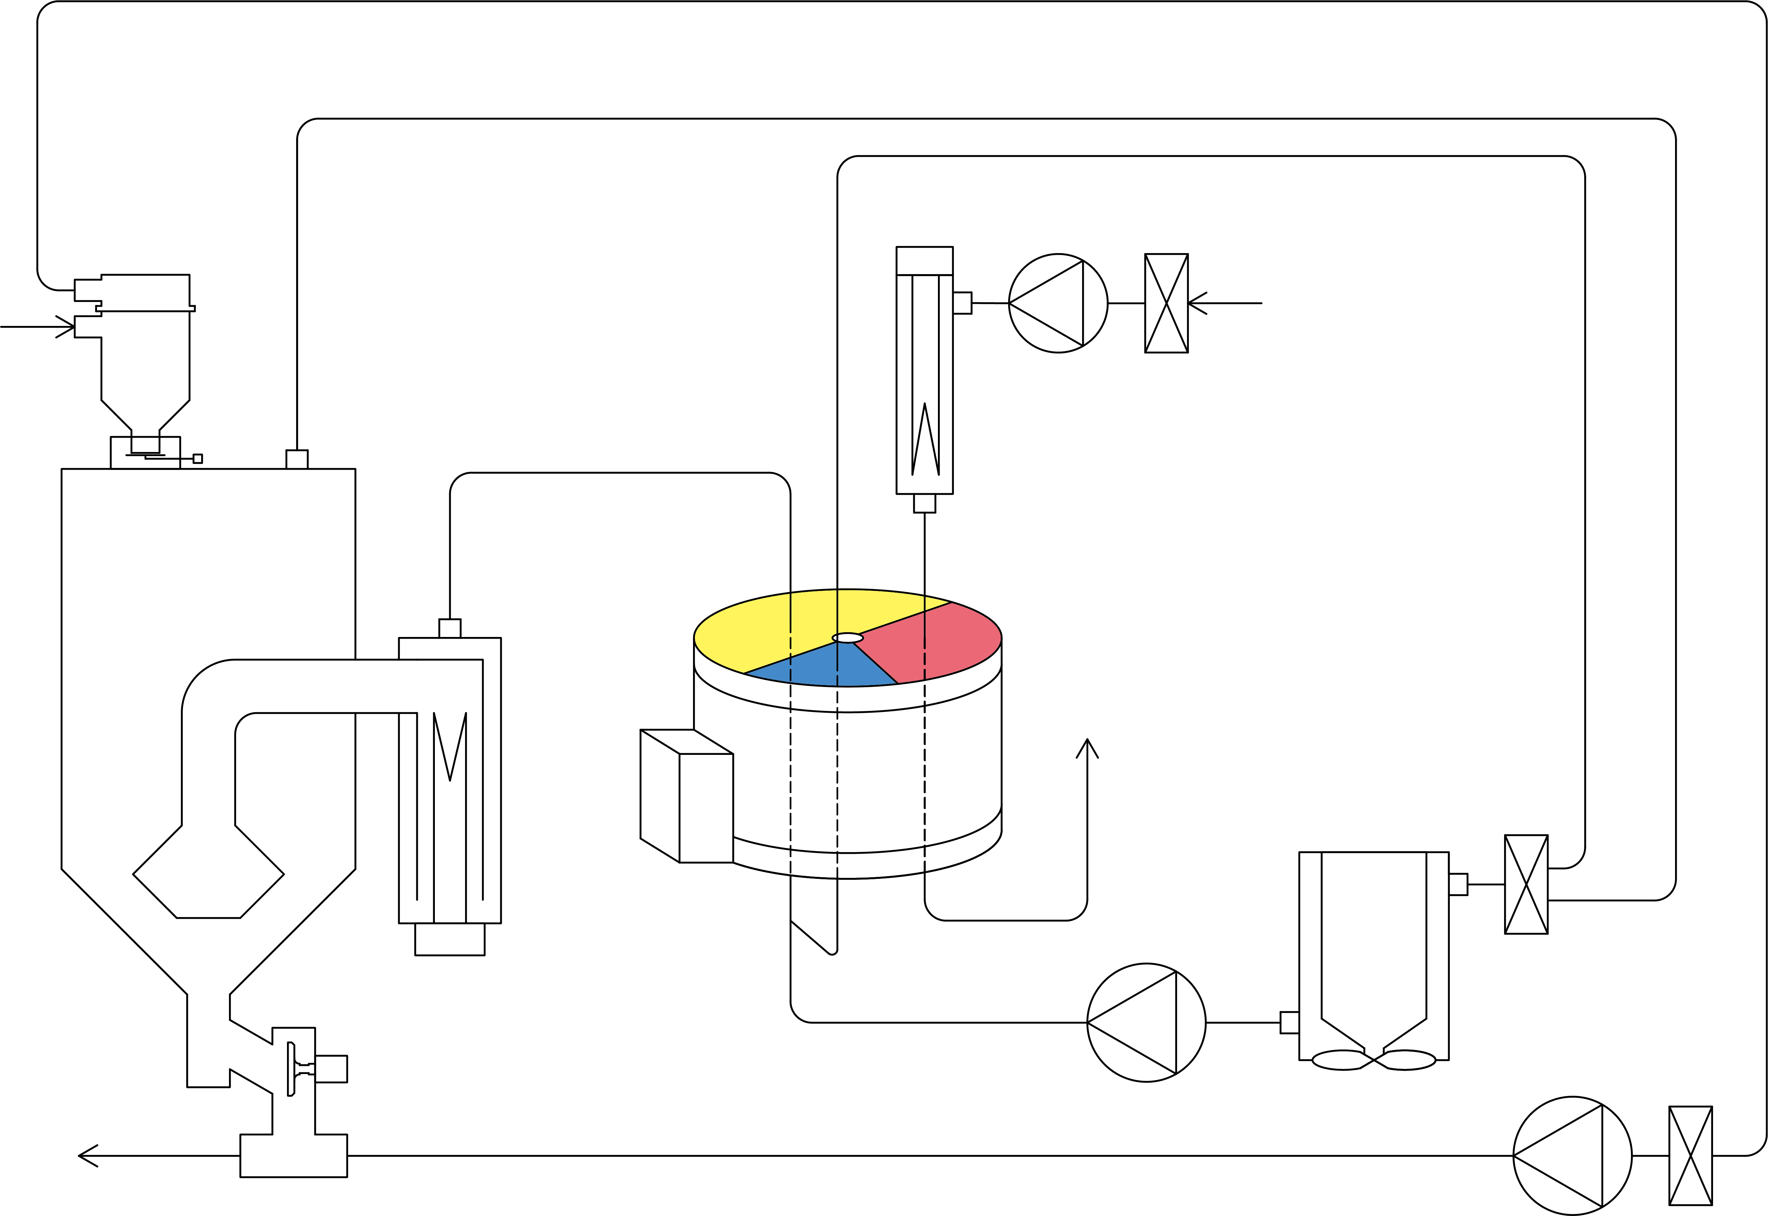

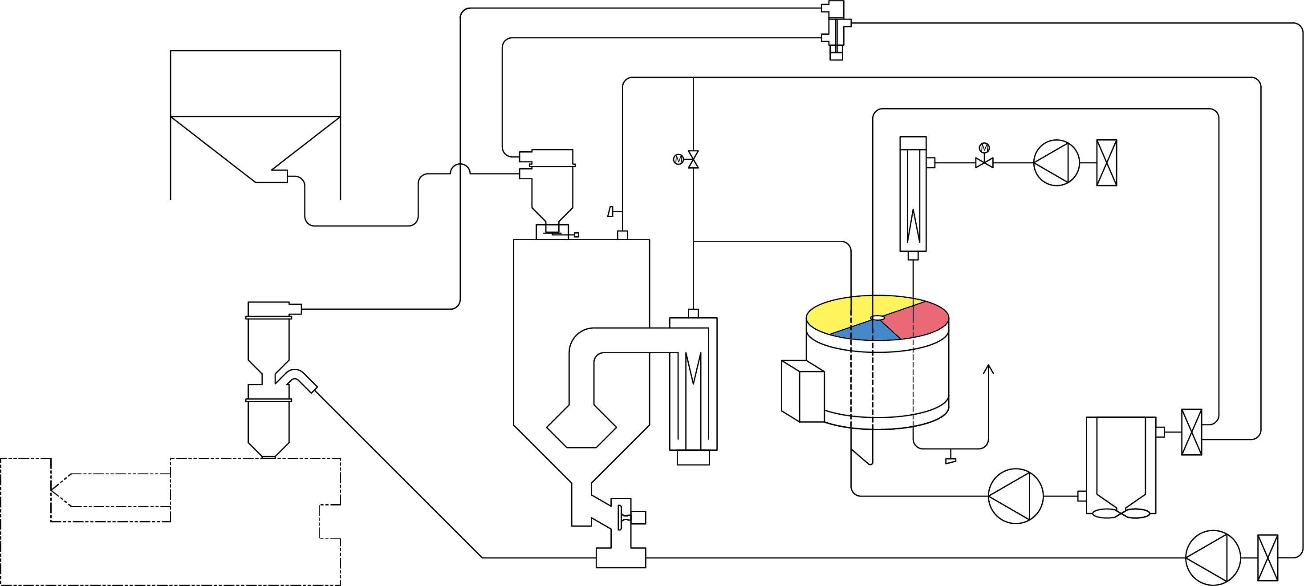
When a dryer was running at
full power (max. dry air flow rate)
even while a molding machine stopped,
But MJ3-SE is
different!
One less
operating machine than usual
Regeneration Heater
When the exhaust temperature of the drying hopper becomes higher than the set temperature, a part of the circulating drying air is bypassed, then the amount of air flow rate supplied to the drying hopper is reduced.
Regeneration
Blower
Drying Hopper
Drying
Heater
Honeycomb Rotor―
After Cooler
Molding Machine
Discharge Valve
Drying Blower
Conveying Blower
Preparation time got longer
Stopped due to
maintenance
Material Tank
Regeneration Heater
The energy was left over
in such a case.
Flow Rate
Adjusting Valve
Temperature
Sensor
Regeneration Blower
Proper air flow rate
Proper
Drying
Proper
Drying
Heater
Heat Radiation
Drying
Hopper
Honeycomb
Rotor
Note 1: The device configuration flow is for MJ3-10.
The device configuration flow varies depending on
the model, but a bypass circuit can be installed in
dehumidified dry air circulation circuit in any model.
Note 2: Heat radiation from after cooler to the room is only for
MJ3-10 to 75 (air cooled).
MJ3-100 to 300 (water cooling) exhaust heat to cooling water.
After Cooler
Molding Machine
Discharge Valve
Drying Blower
Conveying Blower

Slide 3


When a dryer was running at full power (max. drying air flow rate)
while a molding machine stopped,
Supplying only the required amount of
dry air flow rate reduces
the power consumption of dry heater!
Regeneration Heater
Excessive
air flow rate
Regeneration
Blower
When the exhaust temperature of the drying hopper becomes higher than the set temperature, a part of the circulating drying air is bypassed, then the amount of air flow rate supplied to the drying hopper is reduced.
Overdrying
Drying
Heater
Heat Radiation
Drying
Hopper
Honeycomb
Rotor―
Discharge
Valve
Drying Blower
After Cooler
Conveying Blower
- wasting extra heating of the air,
which is irrelevant to temperature rise
of the material, by drying heater.
- excessive temperature rise (overdry)
of the material was caused.
Material Tank
Regeneration Heater
Flow Rate
Adjusting Valve
Temperature
Sensor
Regeneration Blower
Proper air flow rate
Proper
Drying
Is there no problem with the dew point?
Drying
Heater
The dew point is stable because no change in air flow rate through honeycomb.
Heat Radiation
Drying
Hopper
Honeycomb
Rotor
Note 1: The device configuration flow is for MJ3-10.
The device configuration flow varies depending on
the model, but a bypass circuit can be installed in
dehumidified dry air circulation circuit in any model.
Note 2: Heat radiation from after cooler to the room is only for
MJ3-10 to 75 (air cooled).
MJ3-100 to 300 (water cooling) exhaust heat to cooling water.
After Cooler
Molding Machine
Discharge Valve
Drying Blower
Conveying Blower

Slide 4
When a dryer is running at full power (max. drying air flow rate)
while a molding machine is stopped,
Lower exhaust temperature reduces
air conditioning equipment load and
saves energy!
Regeneration Heater
Regeneration
Blower
Lots of
wasted energy
When the exhaust temperature of the drying hopper becomes higher than the set temperature, a part of the circulating drying air is bypassed, then the amount of air flow rate supplied to the drying hopper is reduced.
Overdrying
Drying
Heater
Heat Radiation
High
temperature
Drying
Hopper
Honeycomb
Rotor―
Discharge
Valve
Drying Blower
After Cooler
Conveying Blower
the excess heat was released
from after cooler to outside
of the machine.
Material Tank
Regeneration Heater
Flow Rate
Adjusting Valve
Temperature
Sensor
Regeneration Blower
Proper
Drying
Proper
Is there no problem with the dew point?
Drying
Heater
The dew point is stable because no change in air flow rate through honeycomb.
Heat Radiation
Drying
Hopper
Honeycomb
Rotor
Note 1: The device configuration flow is for MJ3-10.
The device configuration flow varies depending on
the model, but a bypass circuit can be installed in
dehumidified dry air circulation circuit in any model.
Note 2: Heat radiation from after cooler to the room is only for
MJ3-10 to 75 (air cooled).
MJ3-100 to 300 (water cooling) exhaust heat to cooling water.
After Cooler
Molding Machine
Discharge Valve
Drying Blower
Conveying Blower

Slide 5

More Details!
What happens if the exhaust temperature falls below the set temperature?
Dry with an appropriate
air flow rate suitable for
the operating conditions!
When the exhaust temperature is
higher than the set temperature,
Material Tank
Regeneration Heater
Lots of
wasted energy
Excessive
air flow rate
Regeneration
Blower
Overdrying
High
temperature
Heat Radiation
Material Tank
Regeneration Heater
Drying
Hopper
Drying
Heater
decrease the supply amount of
the drying hopper
(increase the bypass flow rate).
Flow Rate
Adjusting Valve
Drying Blower
After Cooler
Proper
air flow rate
Regeneration
Blower
Molding Machine
Conveying Blower
Proper
Drying
Proper
Heat Radiation
When the exhaust temperature is
lower than the set temperature,
Drying
Hopper
Drying
Heater
Material Tank
Regeneration Heater
Discharge Valve
After Cooler
Insufficient
air flow rate
Molding Machine
Drying Blower
Regeneration
Blower
Conveying Blower
Insufficient
drying
Heat Radiation
Drying
Hopper
Drying
Heater
increase the supply amount of
the drying hopper
(decrease the bypass flow rate).
Drying Blower
After Cooler
Molding Machine
Conveying Blower
Note 1: The device configuration flow is for MJ3-10. The device configuration flow varies depending on the model, but bypass circuit can be installed in dehumidified dry air circulation circuit in any model.
Note 2: Heat radiation from an after cooler to the room is only for MJ3-10 to 75 (air cooled). MJ3-100 to 300 (water cooling) exhaust heat to cooling water.

Slide 6

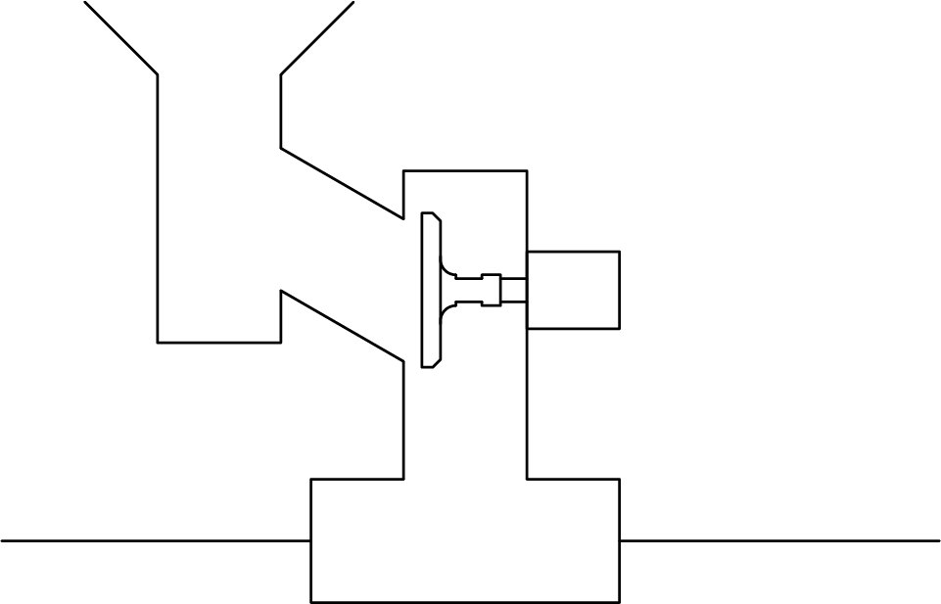
MATSUI technology
also here!
Reabsorption of the material after drying and
temperature drop are reduced by
filling the material conveying line with dehumidified dry air!
Good
Patent No. JP 5130338
Dehumidified Dry Air Circulation Circuit
More Details!
What does “filling the material conveying
line with dehumidified dry air” mean?
Material Tank
Regeneration Heater
Regeneration
Blower
Gap
Drying
Hopper
Drying
Heater
A part of the dehumidified dry air,
supplied to the drying hopper,
flows into the material
conveying pipeline through a gap
between the discharge port.
Honeycomb
Rotor
After Cooler
Molding Machine
Discharge Valve
Drying Blower
～Other expected effects!～
Conveying Blower
Material Conveying Pipeline
Prevent
jammed!
Diagonal mechanism
allows materials to be
discharged smoothly!
The discharge pipe is inclined downward.
Make a gap between the discharge port and the closed discharge valve to prevent material from falling.
Powder pressure
on the valve body is
reduced and the valve
body moves smoothly!

Slide 7
Because
we are MATSUI !
You can retrofit to
existing machines!
MJ3-SE (Drying Adjustment System) is
MATSUI‘s technology that other companies cannot do.
(Patent No. JP 5211056）
When the exhaust temperature of the drying hopper becomes higher than the set temperature, a part of the circulating drying air is bypassed, then the amount of air flow rate supplied to the drying hopper is reduced.
MJ3-10-SE
Material Tank
Flow Rate
Adjusting Valve
Regeneration Heater
Supplying only the required
amount of dry air flow rate reduces
the power consumption of dry heater!
Temperature
Sensor
Regeneration Blower
Good
Proper air flow rate
Proper
Drying
Proper
Drying
Heater
Heat Radiation
Lower exhaust temperature reduces
air conditioning equipment load and
saves energy!
Drying
Hopper
Honeycomb
Rotor
Good
After Cooler
Molding Machine
Discharge Valve
Drying Blower
Conveying Blower

Slide 8

Good ideas
addition to
patented technology
MJ3-SE (Drying adjustment system) not only adjust dry air flow rate but also
adjust the regenerated air flow rate to reduce unnecessary energy consumption of the dryer.
When the honeycomb
regeneration exhaust
temperature is higher than
the set temperature,
Regenerate with an appropriate
air flow rate suitable for
the operating conditions!
Material Tank
Regeneration
Heater
Regeneration Blower
Flow Rate
Adjusting Valve
Excessive
air flow rate
Flow Rate
Adjusting Valve
Lots of
wasted energy
Over
regeneration
High
temperature
Drying
Hopper
Drying Heater
Temperature
Sensor
After Cooler
Material Tank
Regeneration
Heater
Molding Machine
Discharge Valve
Drying Blower
the regeneration air flow rate is
reduced.
Flow Rate
Adjusting Valve
Regeneration Blower
Conveying Blower
Flow Rate
Adjusting Valve
Proper
air flow rate
When the honeycomb
regeneration exhaust
temperature is lower than
the set temperature,
Proper
Drying
Proper
Material Tank
Regeneration
Heater
Regeneration Blower
Flow Rate
Adjusting Valve
Drying
Hopper
Drying Heater
Temperature
Sensor
Insufficient
air flow rate
Flow Rate
Adjusting Valve
Discharge Valve
After Cooler
Molding Machine
Drying Blower
Conveying Blower
Insufficient
reproduction
Drying
Hopper
Drying Heater
Temperature
Sensor
After Cooler
the regeneration air flow rate is
increased.
Molding Machine
Discharge Valve
Drying Blower
Conveying Blower
Note: The device configuration flow is for MJ3-10. For MJ3-10 to 150, the supply air flow rate is adjusted by the flow rate adjusting valve installed between regeneration blower and regeneration heater.
For MJ3-200 to 300, the supply air flow rate is adjusted by an inverter installed in the regeneration blower.

